Slide 1


Slide 2


LAKSHMI NAIRAIN COLLEGE OF TECHNOLOGY EXELLENCE
RAJIV GANDHI PROUDYOGIKI VISHWAVIDYALAYA (RGPV)

Slide 3
MINOR PROJECT-1 (EC-508)
MONITORING AND ALERT SYSTEM
GROUP LEADER :- PRIYA RAJ (0176EC191055)
MEMBERS :- RAHUL TIWARI (0176EC191061)
RIDDIM JAIN (0176EC191064)
PROJECT IN CHARGE :- DR.APARNA GUPTA
PROJECT GUIDE:- PROF.SANKET CHOUDHARY

Slide 4
CONTENT
Introduction
Problem Statement
Platform & Module Used
Working
Applications
Advantages
Disadvantages
Conclusion
References

Slide 5

INTRODUCTION
We have created an AI system in python which can monitor the individuals using the webcam
and later on it will enable us to monitor multiple persons at once
MONITORING & ALERT system has two modules.
.

Slide 6
Module –1st
It monitors the person and create an excel sheet that contains the data duration when the person was in front of the camera.
When the webcam is not able to detect the person then it alerts the user by generating alarm to not leave his working/examination space.
If it is found that the person is not in front of cam for specified times then program will log you out. At last it mails that excel sheet to the assigned authorities.

Slide 7

Module –2nd
This module check weather the person operating the program is authorized to do so or not.
If it detects an unauthorized person then it raise an alert and also capture the unknown face. Then it will send an,alert mail to given mail address , “UNAUTHORIZE PERSON IS USING THE DEVICE”. If the unknown person is detected in front of cam for more than specified time, then program will terminate.

Slide 8

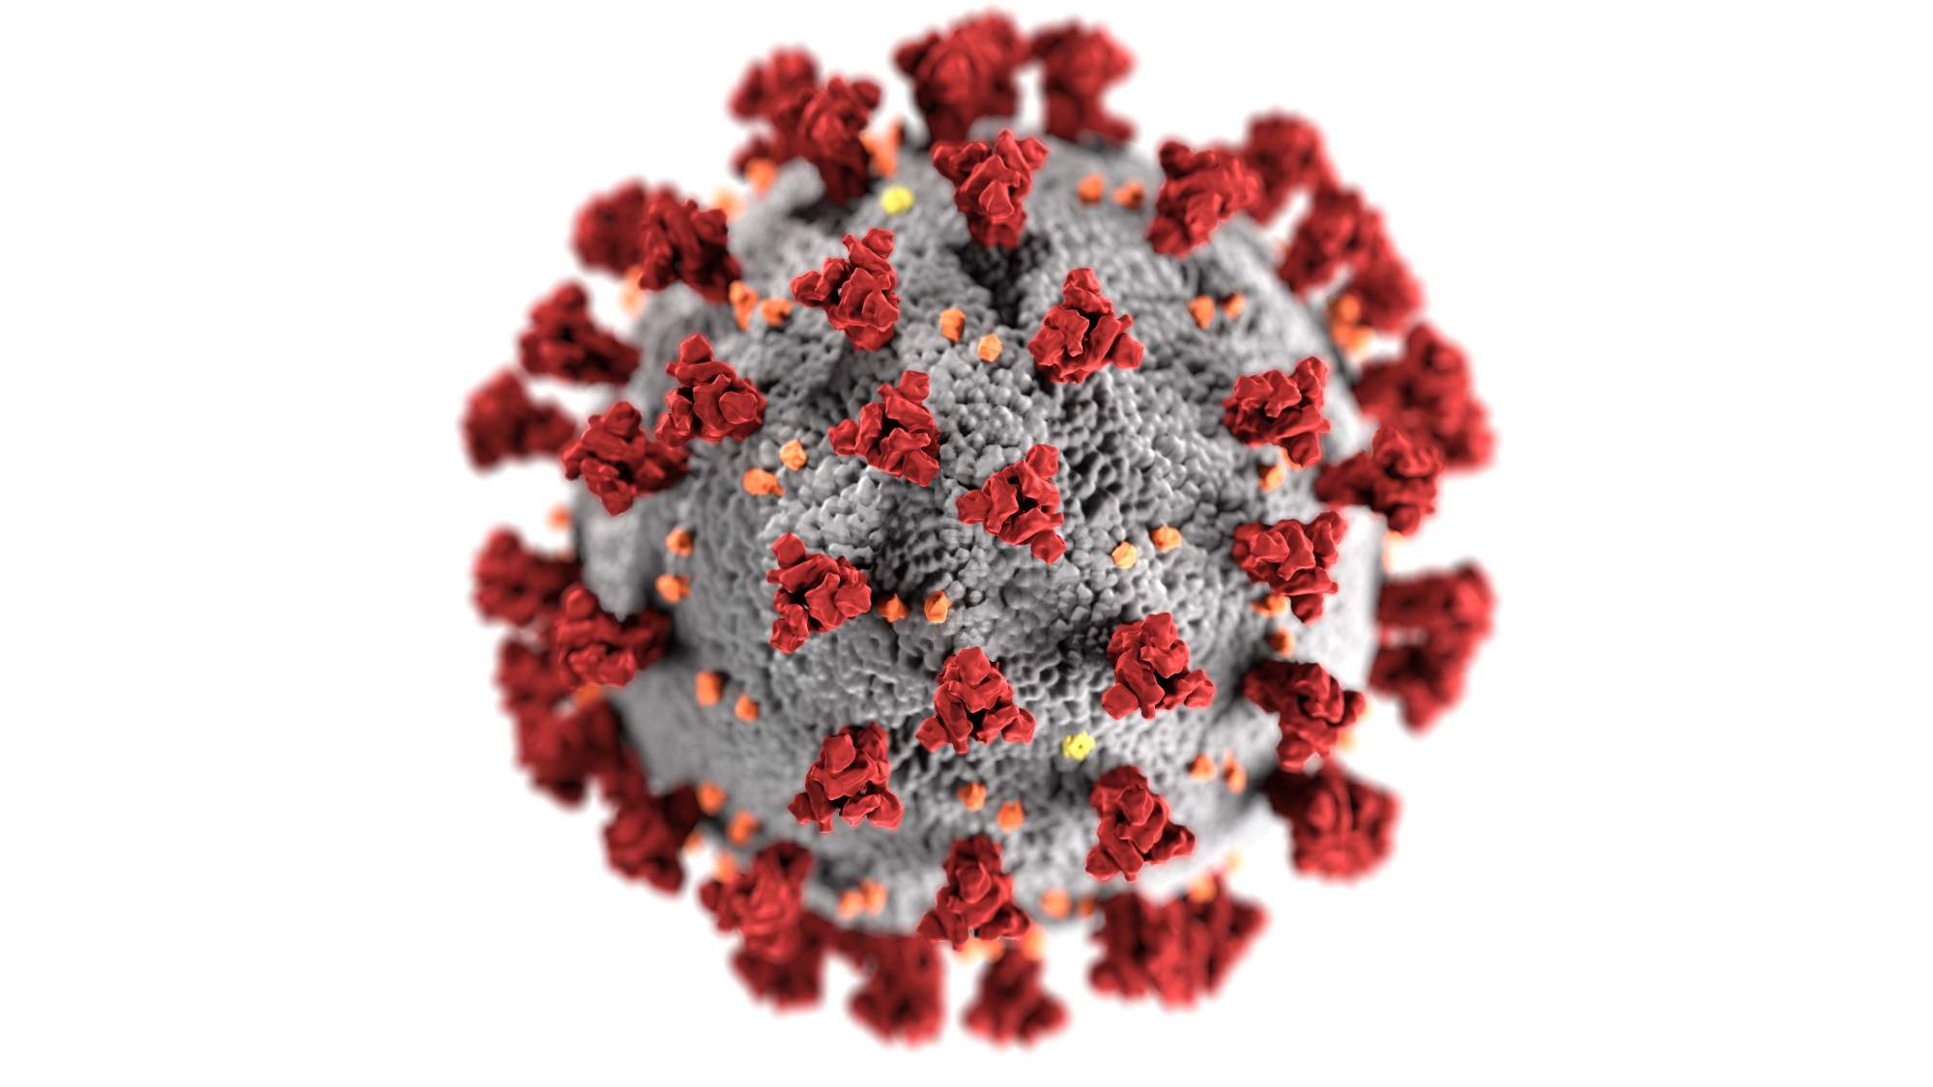
PROBLEM STATEMENT
With the advent of COVID-19, remote working and learning has blossomed. Schools, universities and workplaces may have been shut down but they switched to applications like Microsoft Teams for their works.
Online exams and work from home are conducted with individuals located remotely, which means there is no way of knowing whether they are maintaining the integrity of the test & work and during COVID or post-COVID if the way we are living is to be the reformed there needs to be some solution.

Slide 9

PLATFROM
Python 3.9
TM
It is an interpreted high-level general-purpose programming language.
Its object-oriented approach aim to help programmers write clear, logical projects.

Slide 10




MODULE’S
OPEN CV- OpenCV is a important library of programming functions mainly aimed at real-time computer vision.
TKINTER- Tkinter is a Python binding to the Tk GUI toolkit. It is the standard Python interface to make interface GUI.
NUMPY- NumPy is a library for the Python programming language, adding support for arrays and matrices, along with high-level mathematical functions to operate on these arrays.
FACE -RECOGNITION -Facial recognition is a way of recognizing a human face through technology and CAN HELP TO VERIFY A PERSONS IDENTITY. Facial recognition software reads the geometry of your face. The software identifies facial landmarks — one system identifies 68 of them — that are key to distinguishing your face.

Slide 11
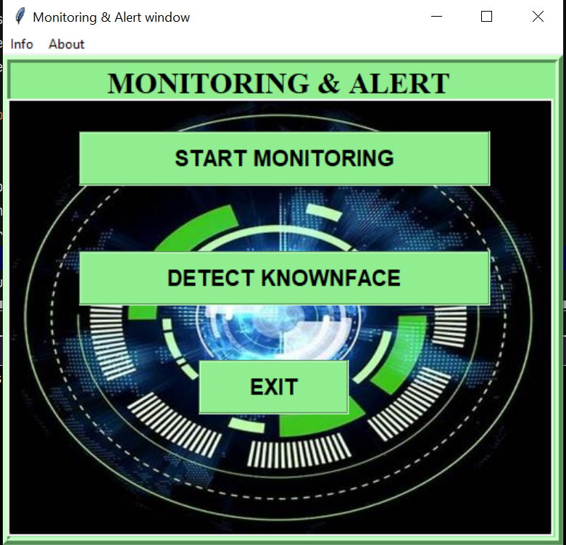
WORKING
GUI:-The graphical user interface is a form of user interface that allows users to interact with electronic devices through graphical icons and audio indicator such as primary notation, instead of text-based user interfaces,
command labels or text navigation
In our project we have created three command buttons-
Module 1’s button
Module 2’s button
Exit button.
The whole process, can be described as the combination of two important process –
Moving object detection and segmentation from the video frames.
Drawing the bounding boxes around the detected moving objects.

Slide 12
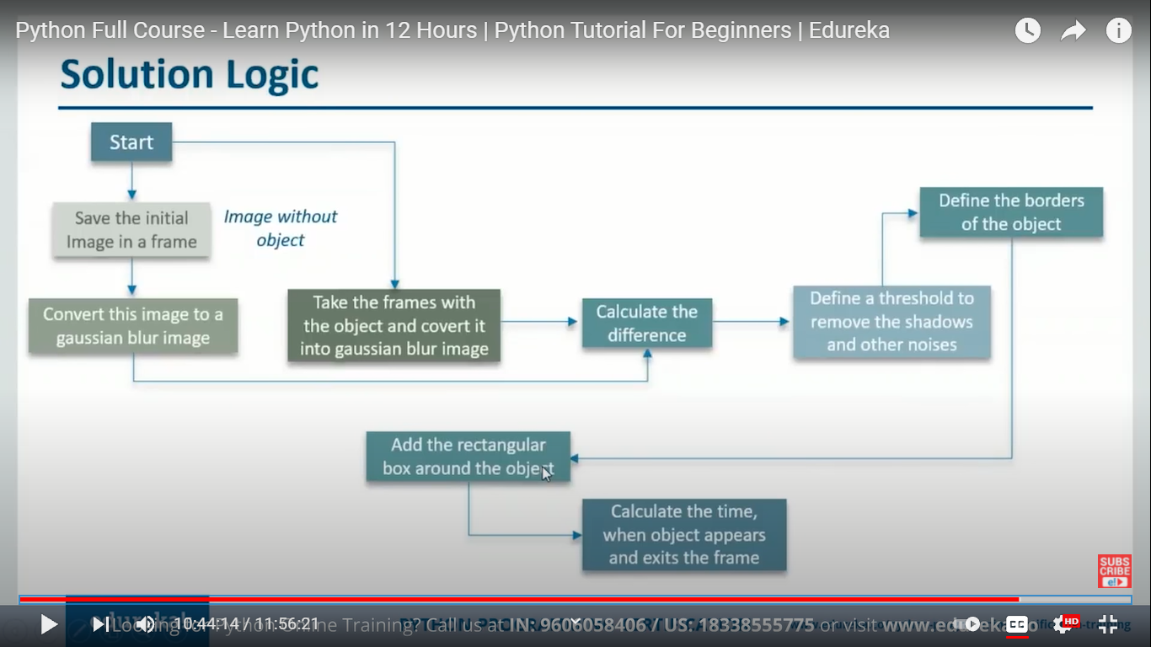
Module 1’s
INTERNAL WORKING

Slide 13
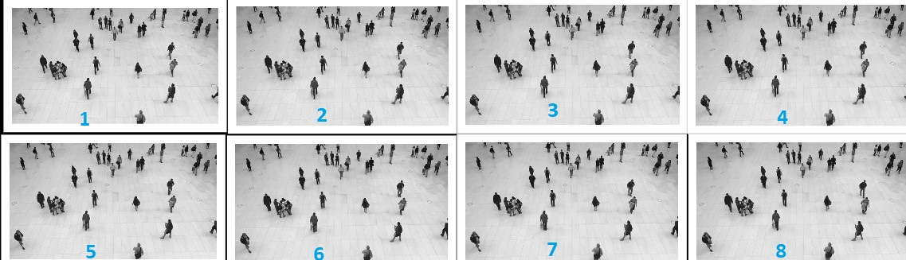
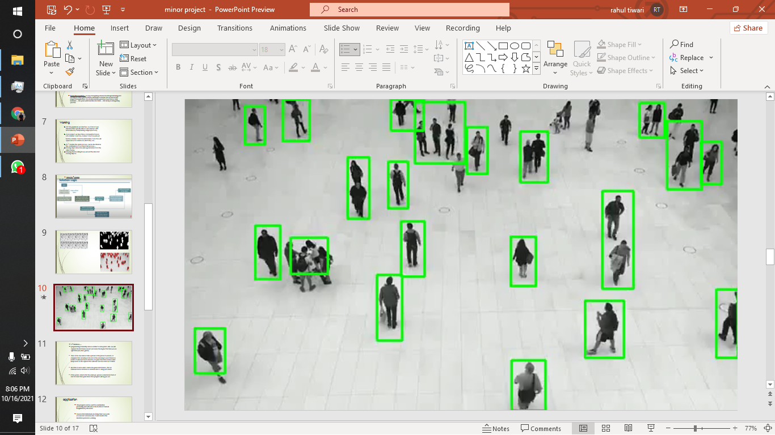
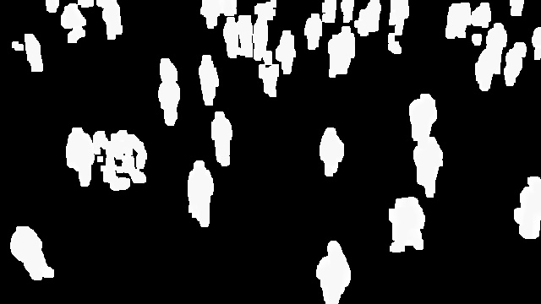
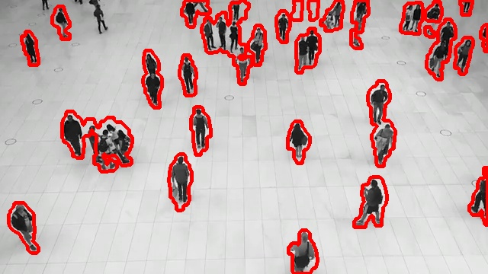


Slide 14
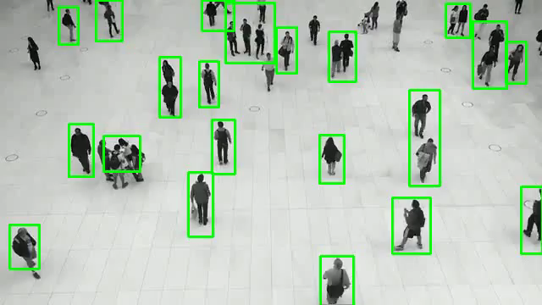

Slide 15
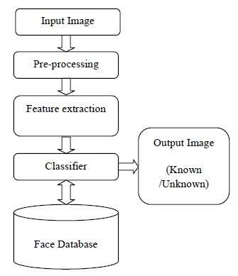
Module 2’s
INTERNAL WORKING
These module is basically same as earlier to some points. It also capture the first frame ,convert and resize the image but this time we use “RGB” frame (red, blur ,green).
It compares that encoding to the rest of the encoding to see if there is a match. If unknown face is detected, for given time then it raise a alert beep sound. It also capture that unknown face and save it in a folder.

Slide 16


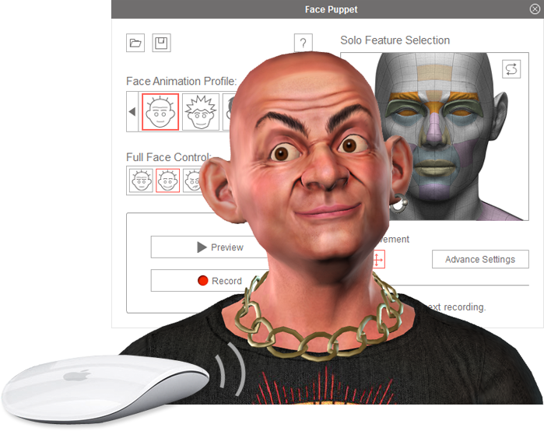
And then it send a alert mail to the given mail address , that an unknown face is detected or someone else is using your device
JHON MERCY
MISS ALEASA
UNKNOWN
BEEP SOUND
ALERT MAIL SENT
NO BEEP SOUND
NO BEEP SOUND

Slide 17
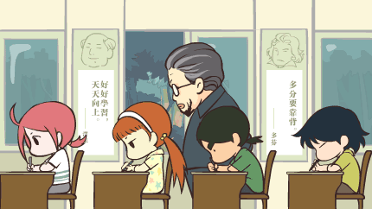

APPLICATION
This program can be used for examination proctoring and will reduce the burden of manual invigilation by educators.
Ensures that individuals are doing their own given work and not someone else. It also monitor the duration a person is working.

Slide 18
ADVANTAGES
Our system ensure your privacy. And try to leave least faceprint possible.
Can act as an excellent option for Increasing the scalability of Exam as it will make going to physical center a voluntary activity rather than a compulsory one.
In accidental cases when someone else using Our device we can record there picture.

Slide 19
DISADVANTAGES
One of the most observable mistake is heavy dependency on the quality of cam and the amount of lighting in the room.
And it also make it compulsory to turn on low security in Gmail for submission of work and exam report to work.

Slide 20
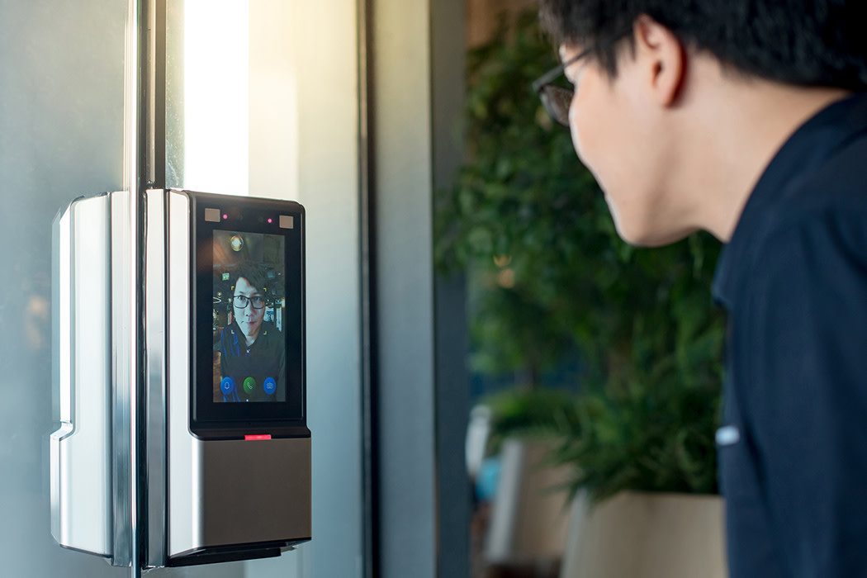

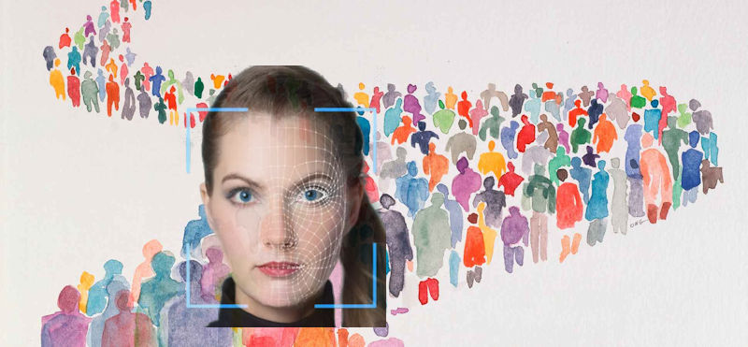
FUTURE SCOPE
This system can act as face lock in home or office and
act as a ledger of people trespassing the vicinity of place
In some new EV’s it can also be used as anti theft system.
It can also help us to track and find people in the vicinity of required place

Slide 21
CONCLUSION
With the advent of COVID-19, remote working and learning has blossomed. However, there has been very little solution to monitor the quality and maintain integrity of work. Somewhere it has changed to an google forms where students can just copy and paste from the internet, while some have just canceled them outright.In addition to traditional test venues. This system supports accessible testing in remote areas, for people who can’t travel, etc. And it enables a more personalized provision in future.
Our project is designed to monitor basically faces and there movement when we open it a GUI window will appear and we have mainly 2 option either to just detect the presence of the user or to detect that the authorized person is there or not. Totally it is based on python and its libraries , there are mainly 68 facial landmarks necessary for face detection and recognition . Why we think of these can be a question, as we all are the part of these all work from home since one and half year and all have noticed the difficulties . Therefore , to make one-self to be alert while working without the work atmosphere and to maintain there focus

Slide 22
refrences
Berkey, Dennis & Halfond, Jay. (2015) Cheating, Student Authentication and Proctoring in Online Programs. New England Journal of Higher Education, http://www.nebhe.org/thejournal/cheating-student-authentication-and-proctoring-in-online-programs/
Karim, Michael & Kaminsky, Samuel & Behrend, Tara. (2014). Cheating, Reactions, and Performance in Remotely Proctored Testing: An Exploratory Experimental Study. Journal of Business and Psychology, 29. 1-18. 10.1007/s10869-014-9343-z.
M. Günther, D. Haufe and R.P. Würtz. Face recognition with disparity corrected Gabor phase differences. In Artificial neural networks and machine learning, volume 7552 of Lecture Notes in Computer Science, pages 411-418. 9/2012.’
Python 3.9.0 is the newest major release of the Python programming language, and it contains many new features and optimizations, https://www.python.org/downloads/release/python-390/
Facial recognition using open cv , https://www.datacamp.com/community/tutorials/face-detection-python-opencv

Slide 23
THANK YOU…

